Slide 1

Zowe 1Q 2023 PI Planning
TSC Focus
Presenters: Jakub Balhar

Slide 2

Mission
Simplify the usage of the zOS
Reduce the learning curve for zOS
Attract new people to zOS
Build great community
Crocodile saving the mainframes

Slide 3
Themes

Slide 4

Security
Dev Sec Ops
Integrating security practices deeper in development
Open SSF Foundation recommendations
Safe Lock

Slide 5

Resilience and Fault Tolerance
How zowe behaves under problematic circumstances?
What happens in HA setups when the instances fail?
What if the amount of traffic gets over certain threshold?
Really resilient plane

Slide 6

Feedback
Deeper integration with the users
More tools to get feedback and adapt direction based on it
Guillotine mailbox

Slide 7

Mentorships
Pipeline for the projects and mentors
Better integration with LF and OMP mentorship programs
Teaching pythons automation

Slide 8

Hybrid Environments
API Economy
Zowe APIs, Vendor APIs, Customers APIs
Complex deployments
Multiple sysplexes + Cloud
Living within Hybrid environment

Slide 9
Policies

Slide 10

Assets
What types we have?
How do we want to store them?
How do we collaborate?
Old and new Assets

Slide 11

Testing
Unit testing
Functional Testing
Acceptance Testing
Penetration Testing
Codify Best Practices
Testing systems

Slide 12
Plans

Slide 13

Education and certification
First course
Explore the options for interactive courses
The greatest certificate

Slide 14

Event Management
Workgroup to take next steps
Help integrate Mainframe in the overall observability
Events over the world

Slide 15
Question of the month

Slide 16
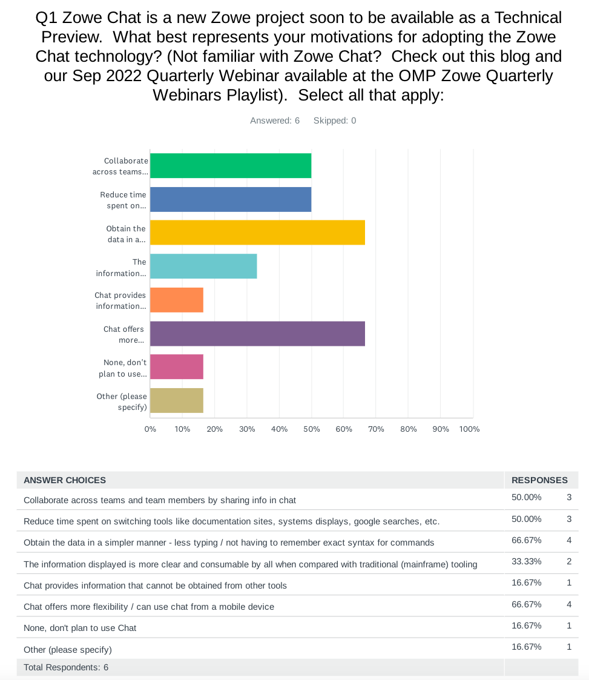
October

Slide 17
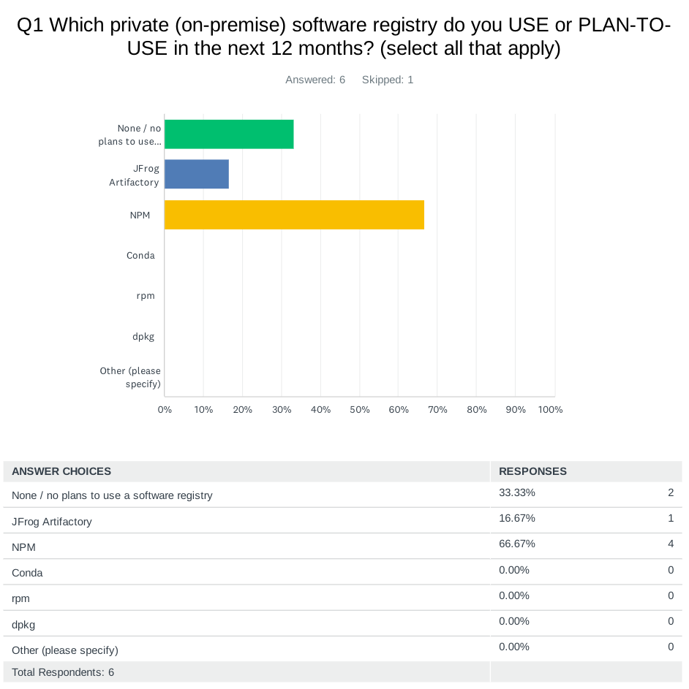
November

Slide 18
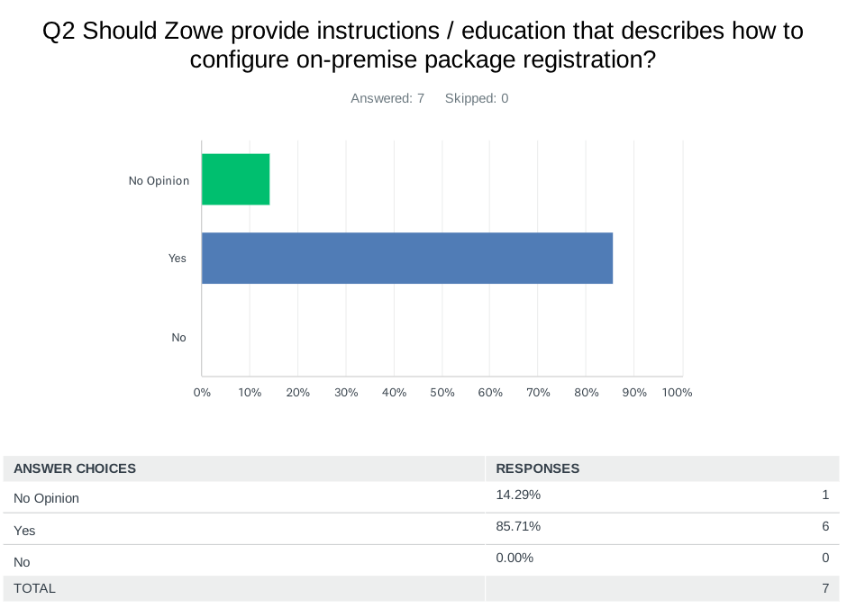
November

Slide 19
State of the issues

Slide 20
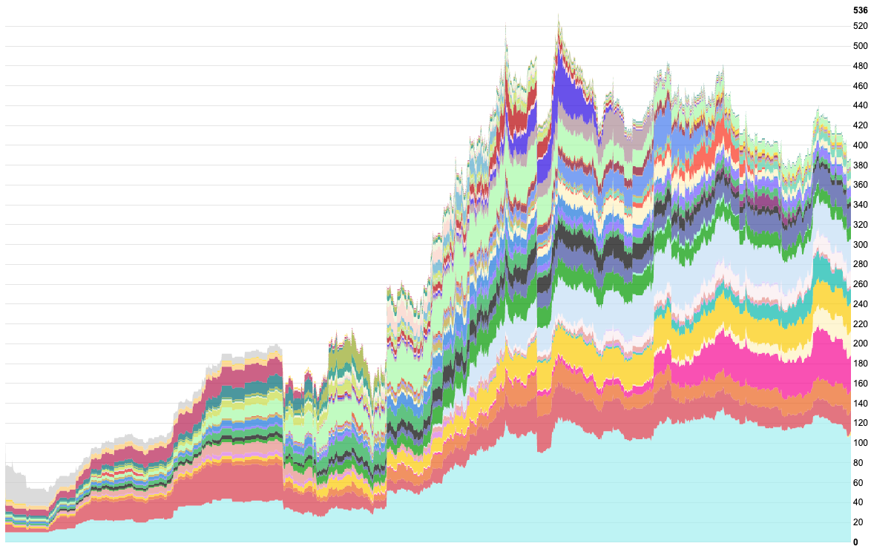
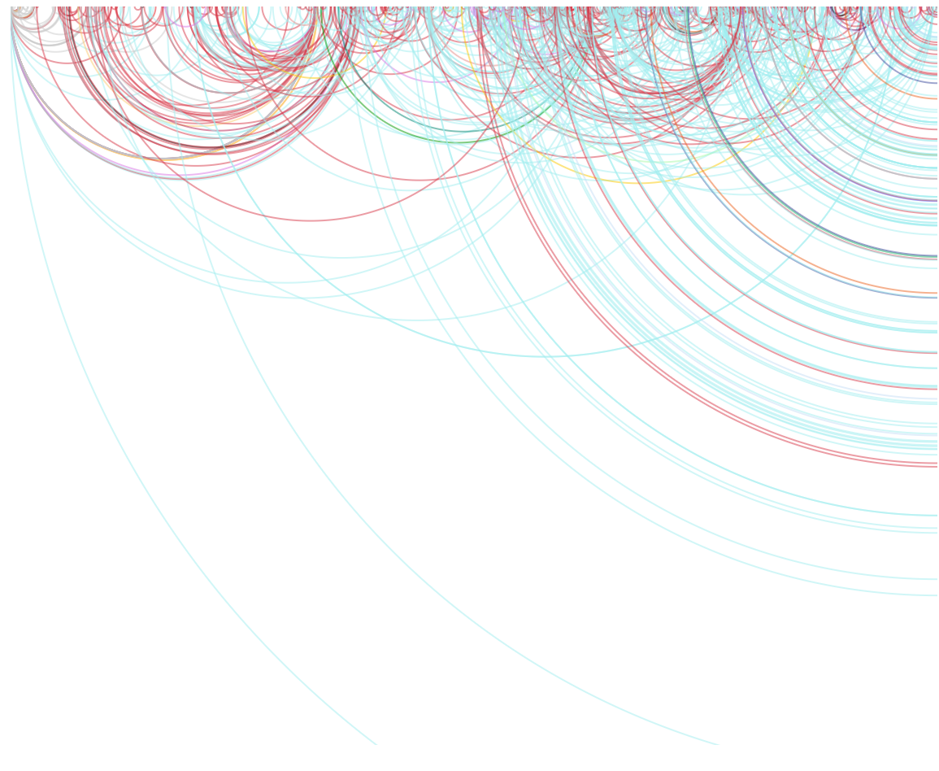
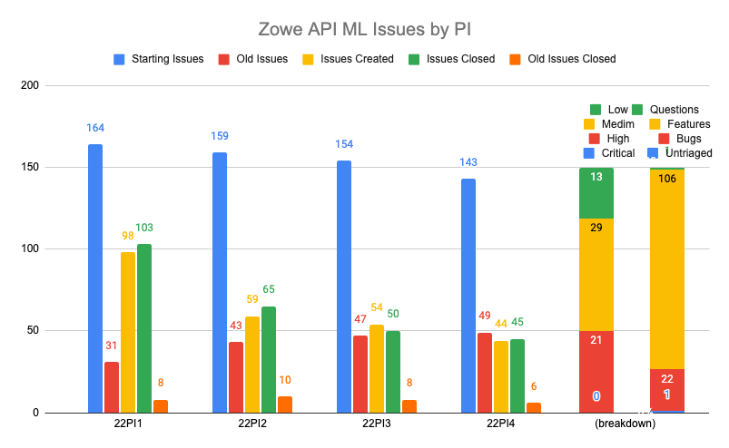
API Mediation Layer

Slide 21
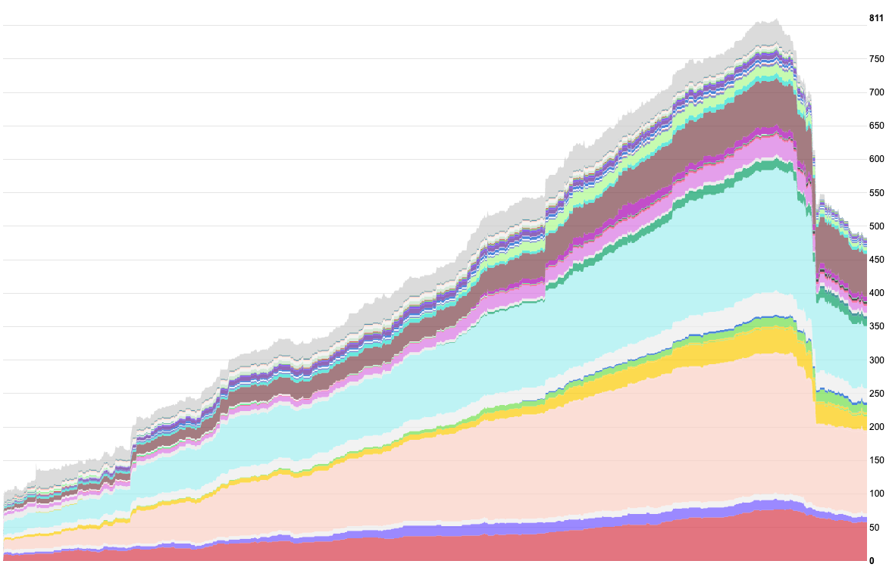
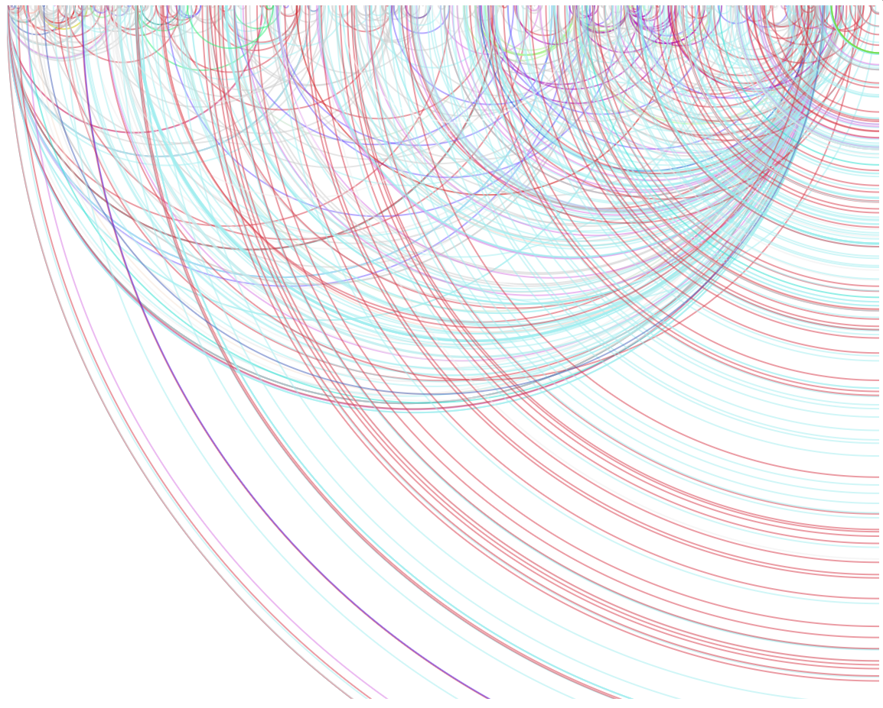
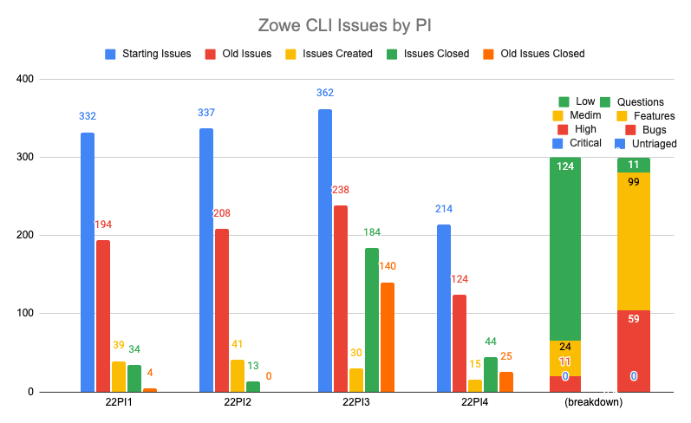
CLI

Slide 22
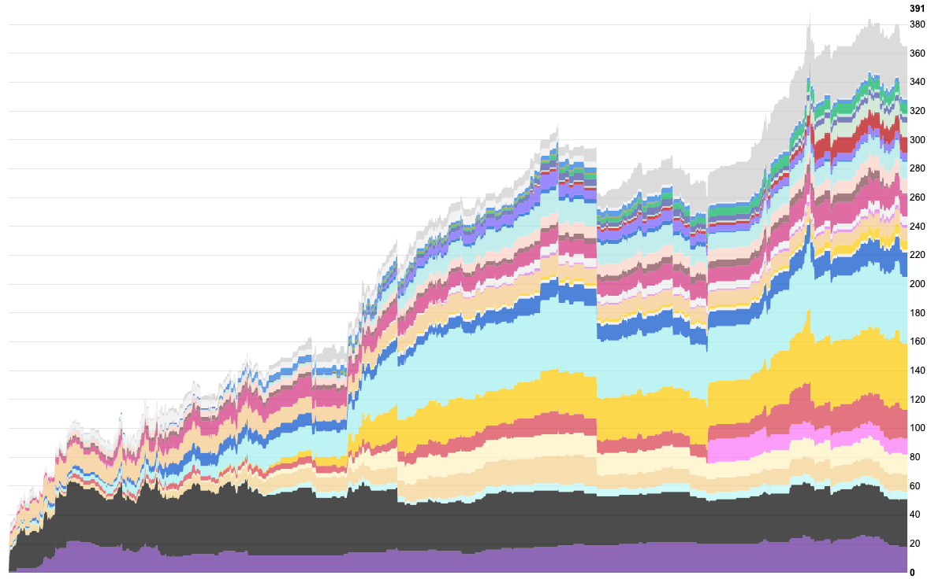
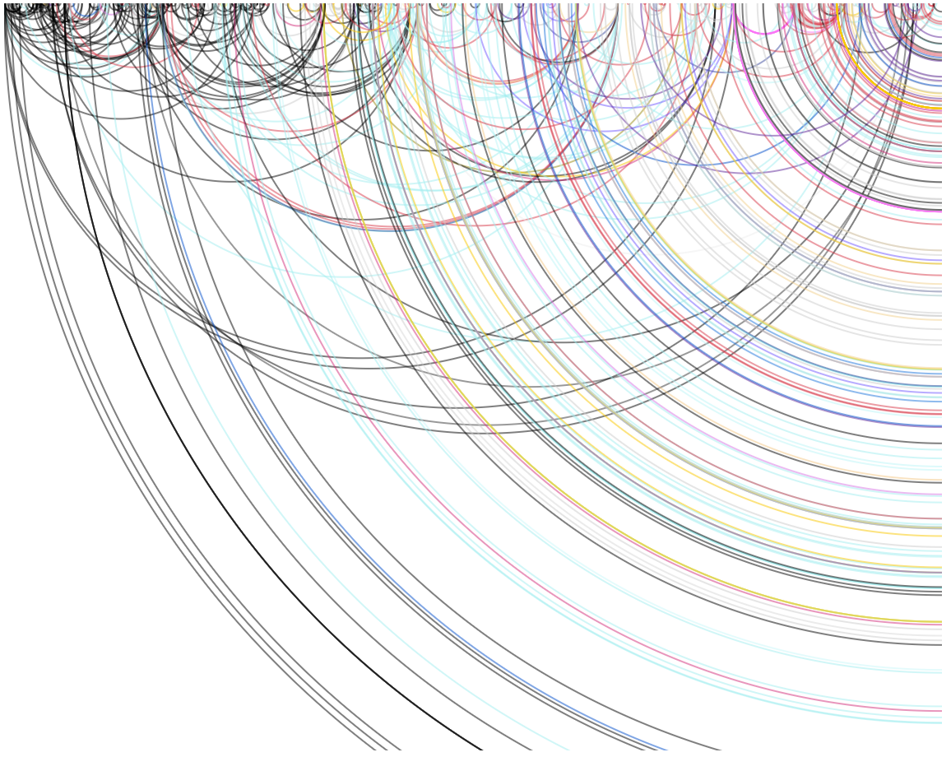
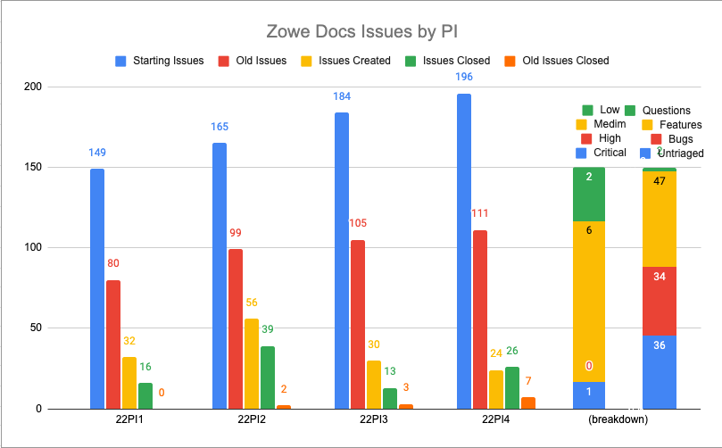
Docs

Slide 23
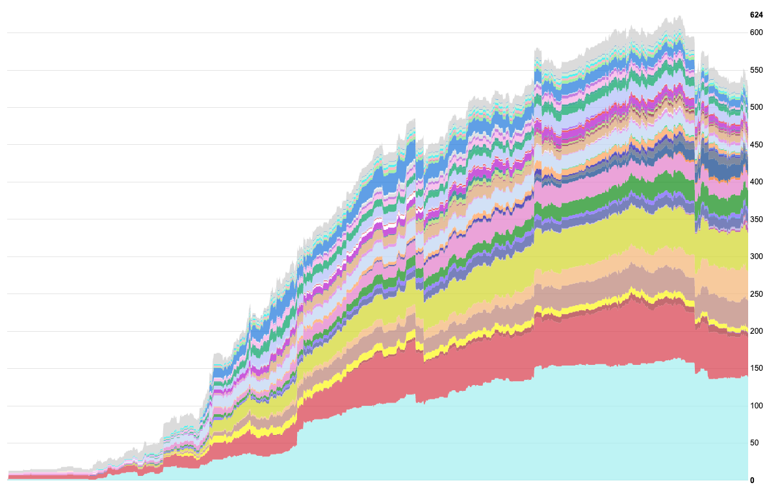
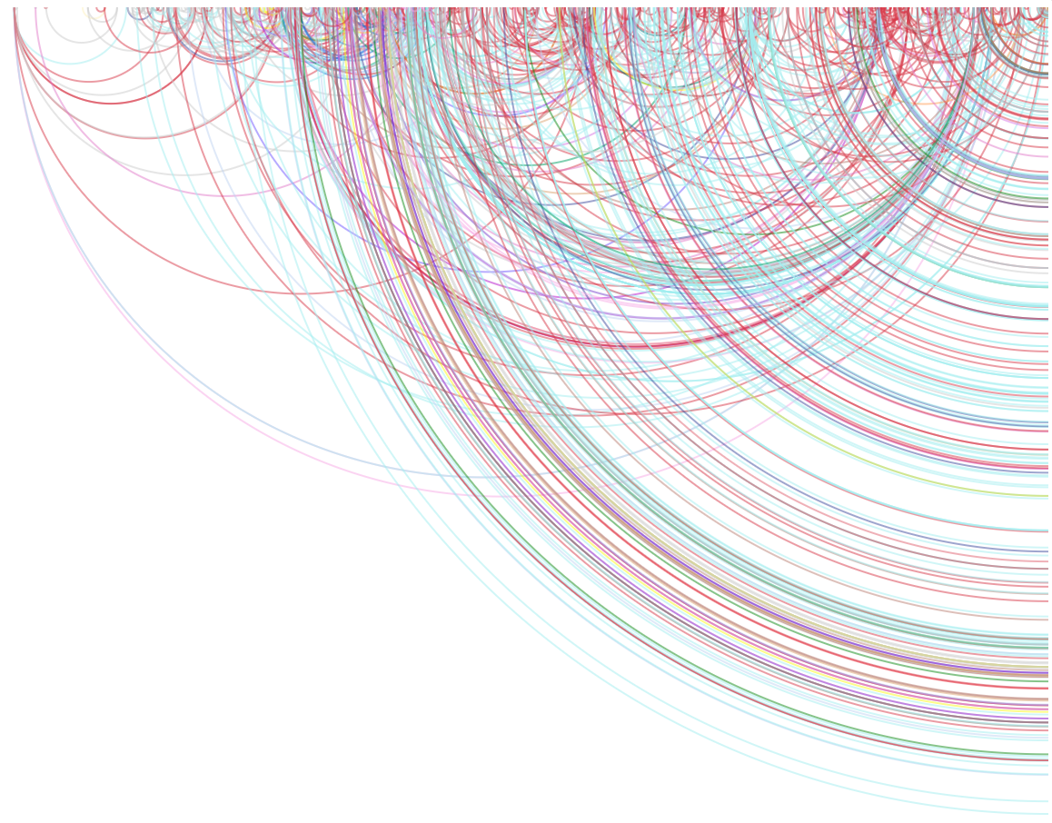
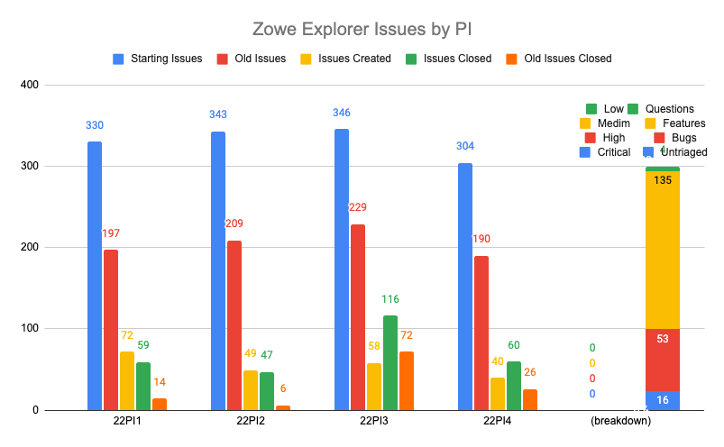
Explorers - VSCode

Slide 24
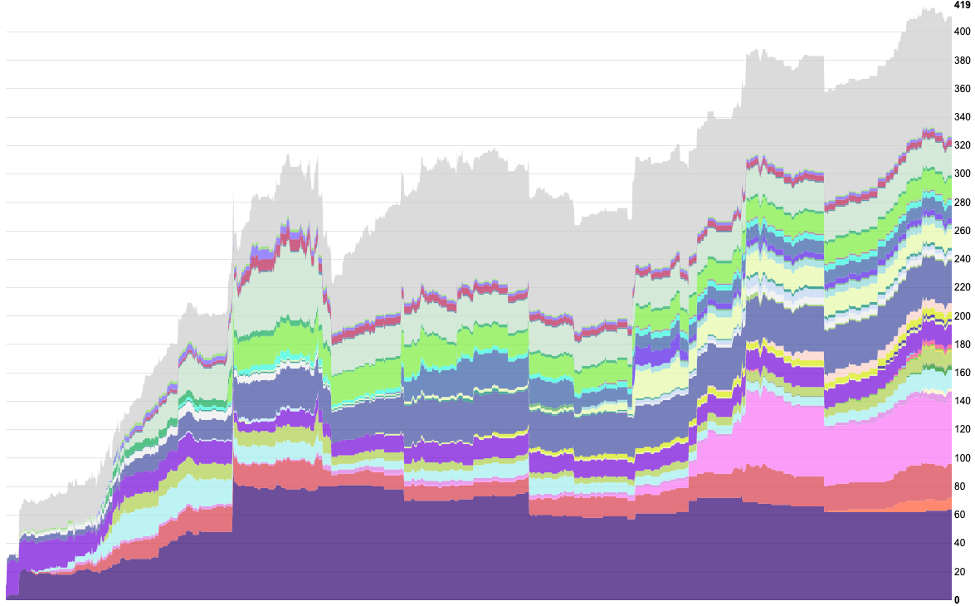
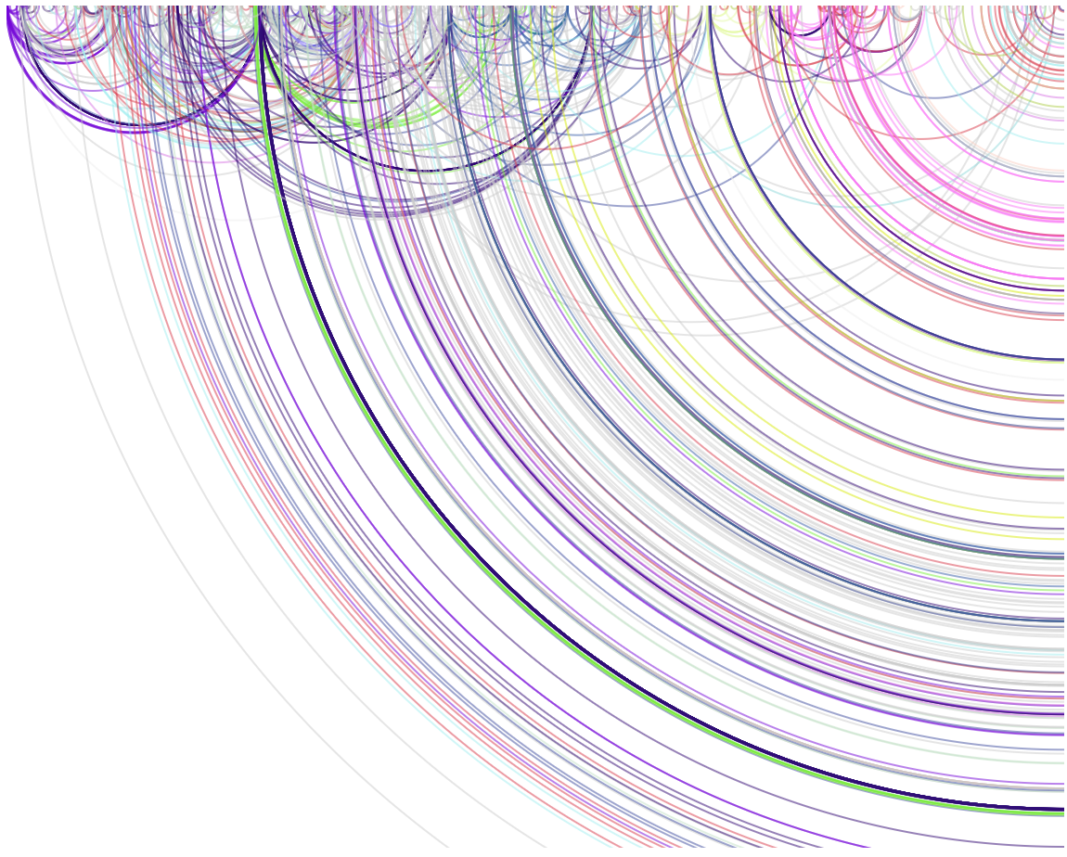
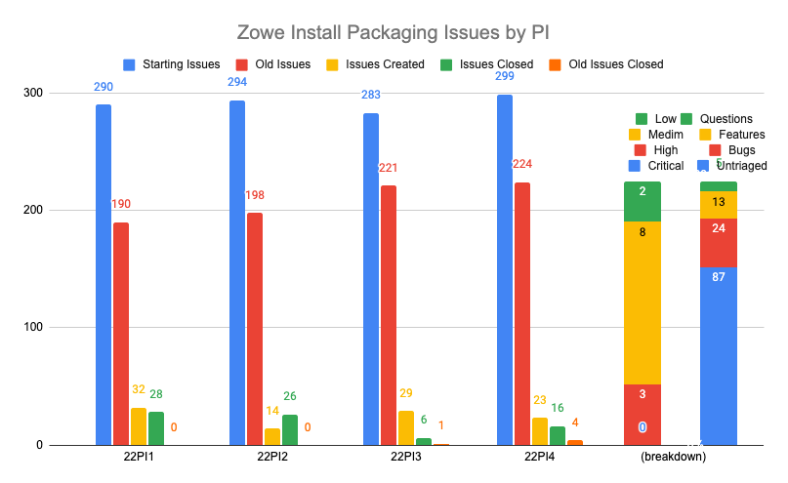
Installation and packaging

Slide 25
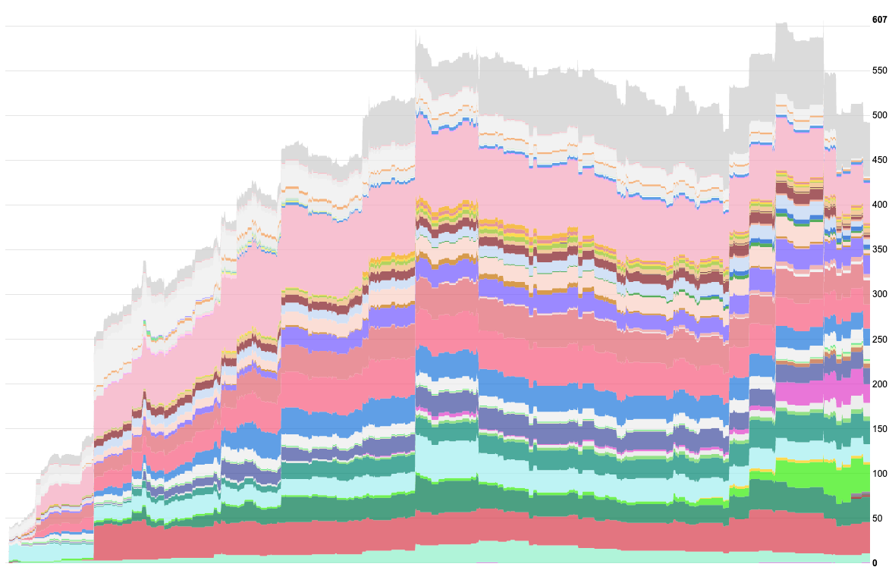
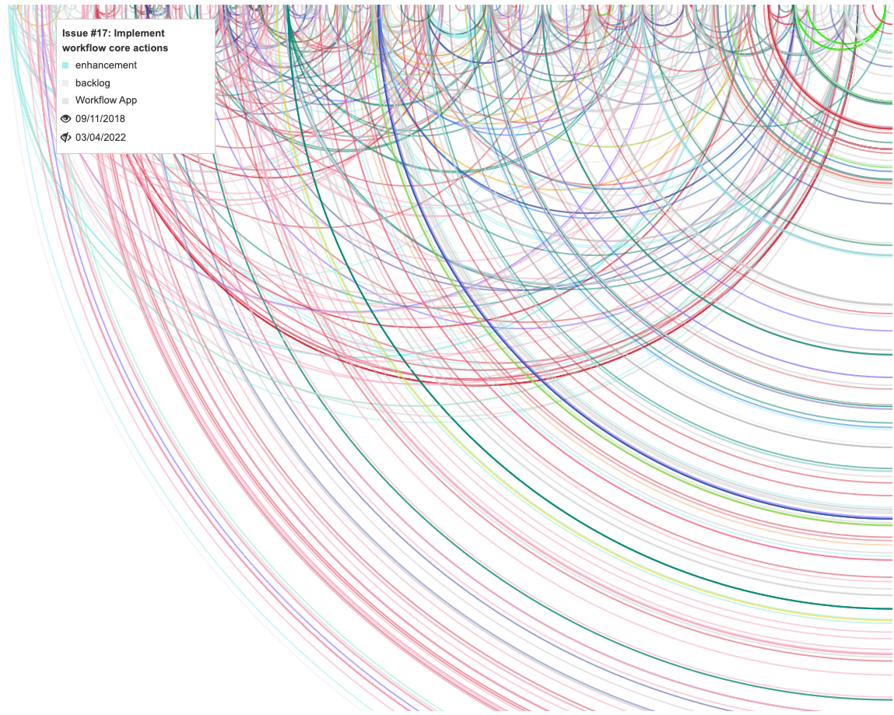
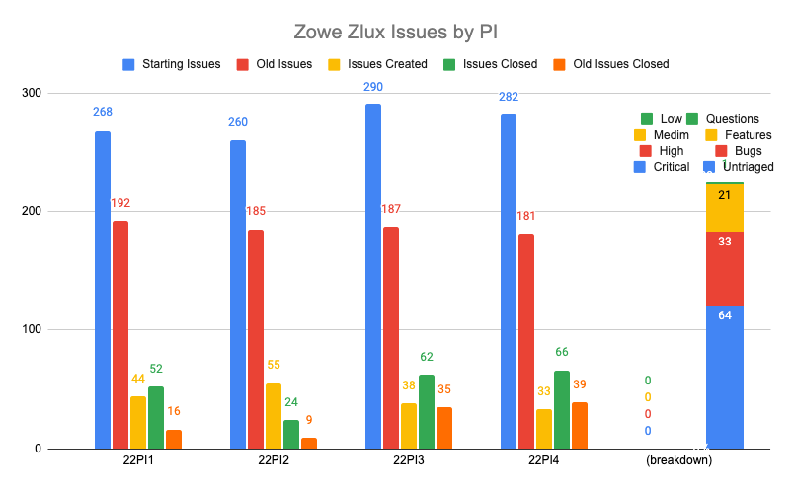
ZLUX

Slide 26
State of the community

Slide 27
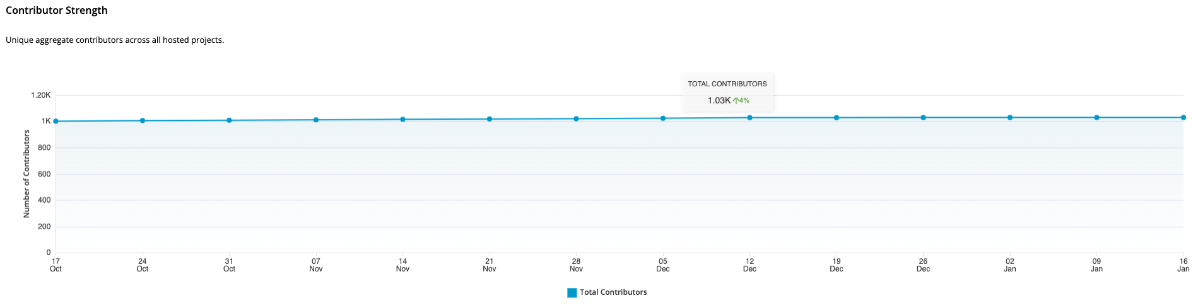
Contributors

Slide 28
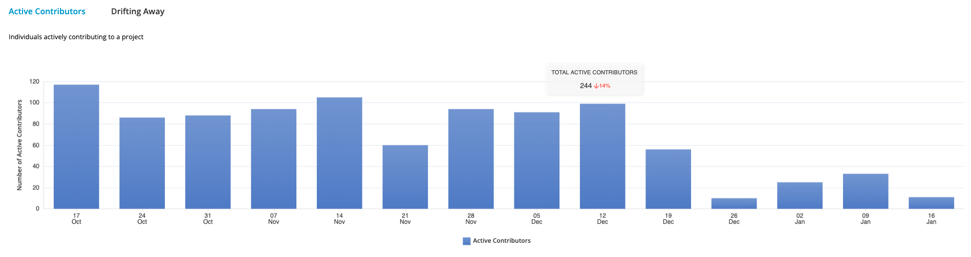
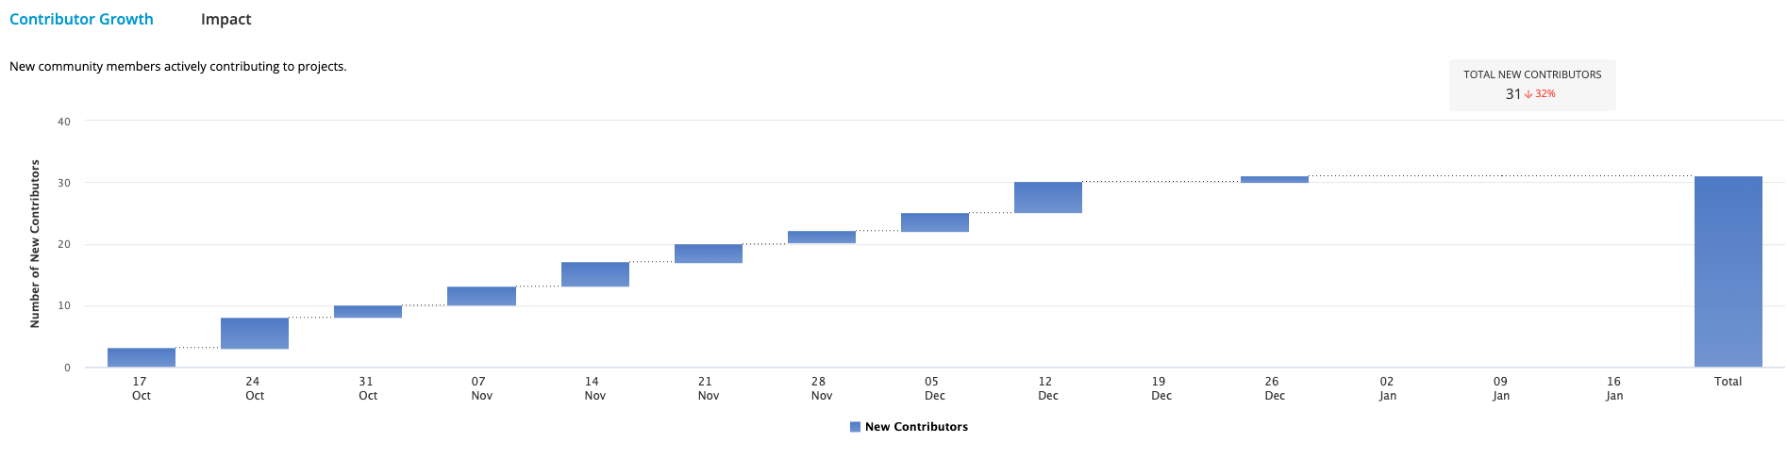
Contributors Change

Slide 29
State of the code

Slide 30
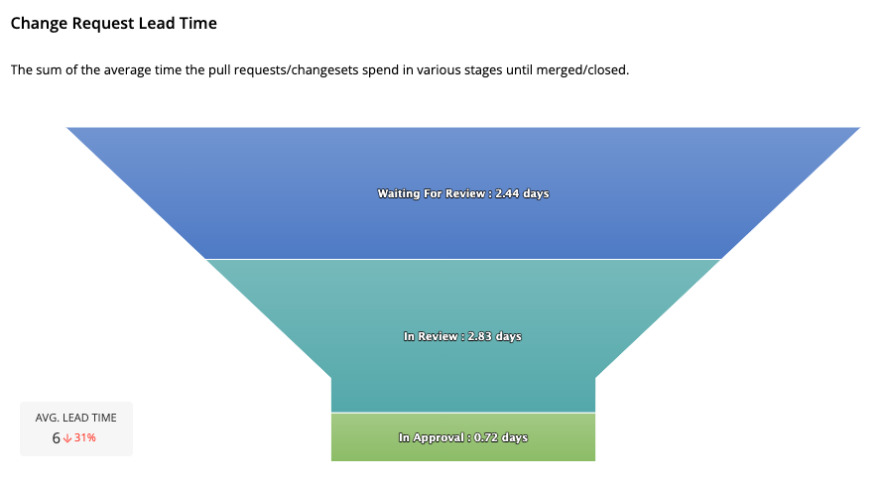
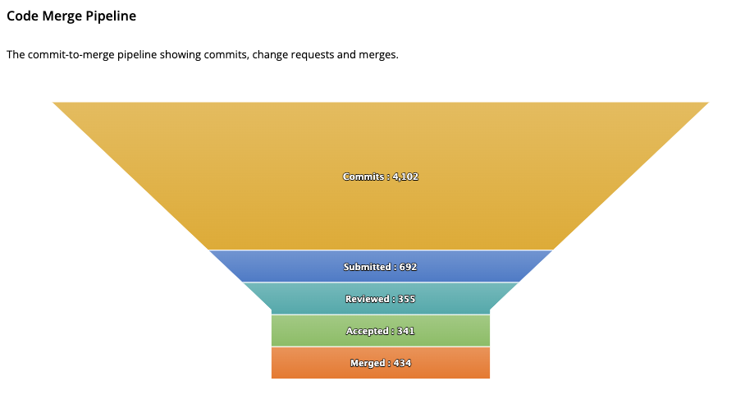
Code Pipeline

Slide 31
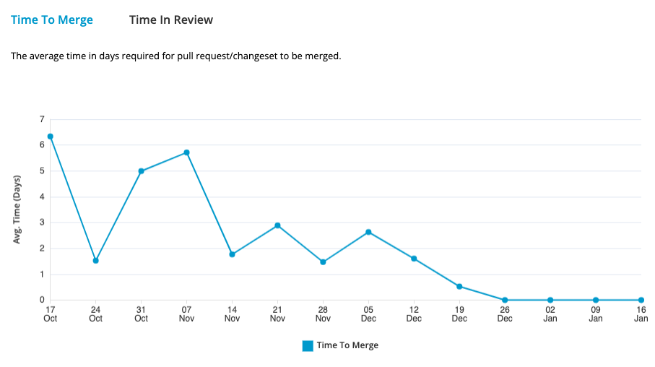
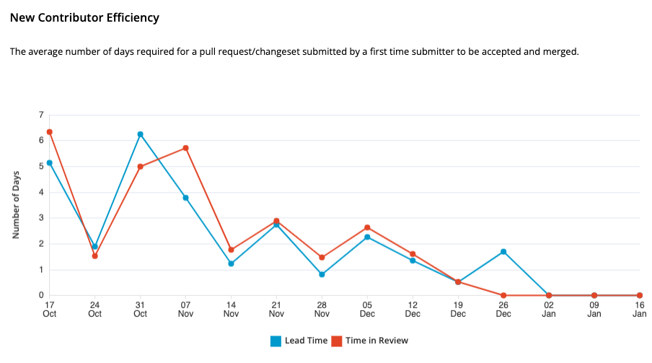
Merge / Review

Slide 32
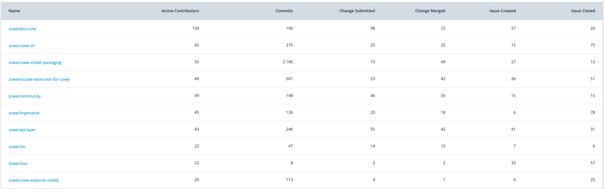
Repository Slides

